Slide 1
2D Finite Elements
Stationary solution
Version 2017.1

Slide 2


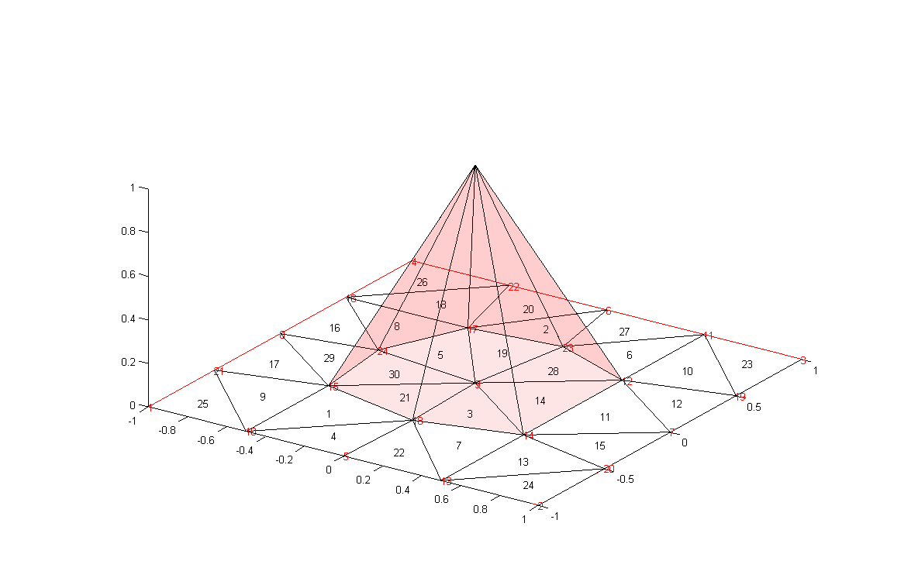
Finite elements
The method is based on the projection of the weak form of a differential equation on functions with limited support
We choose the base functions as pyramidal functions
with a vertex in , unitary
height and base made
by all the triangles having
a vertex in

Slide 3
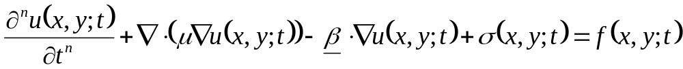
Diffusion-transport-reaction equation
During the course we focus on the (temporal evolution of the) diffusion-transport-reaction problem in 2D:
This equation is used to model many physical phenomena, and plays an important role in different fields:

Slide 4
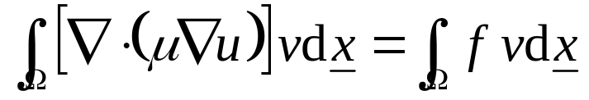
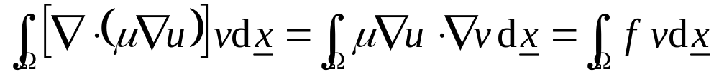

Finite elements
Let’s start with the stationary Poisson equation: we project it on an arbitrary test function v
We apply Green theorem and consider homogeneous Dirichlet and Neumann B.C.
This is the weak (variational) formulation of the problem. Any solution of the initial differential equation
is also a solution of the variational formulation of the problem, while the contrary is only true when some conditions apply on the domain and the problem coefficients. The solution of the variational problem is called weak solution of the differential equation

Slide 5
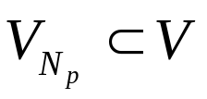
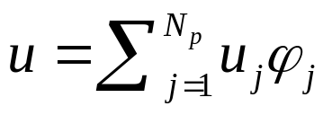
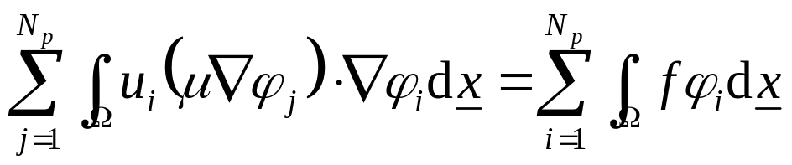
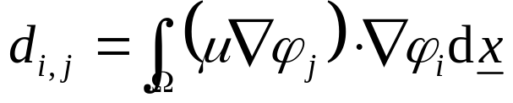
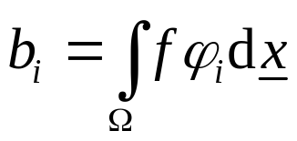
Finite elements
Once we have chosen the base functions as N_{p} functions with finite support defined on the domain
, we express u as
We have to consider N_{p} equations in u_{i}
like
To solve with MatLab the problem in the form Du=b we have to calculate the integrals

Slide 6
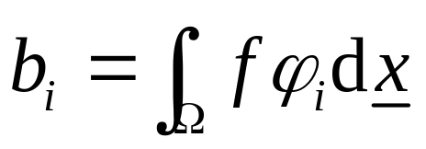
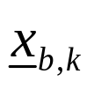
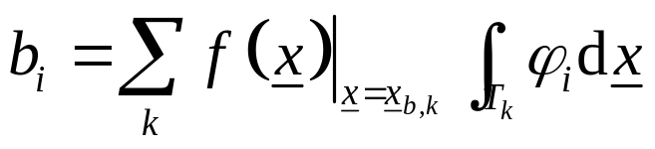
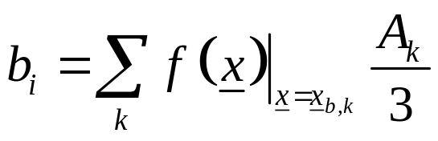
Constant terms vector
For any triangle T_{k} with area A_{k} belonging to the support φ_{j} we can estimate the force in its center of mass and consider it as a constant
We obtain therefore
,
but this integral is simply
the volume of a pyramid
with unitary height and
base A_{k}
Therefore,

Slide 7
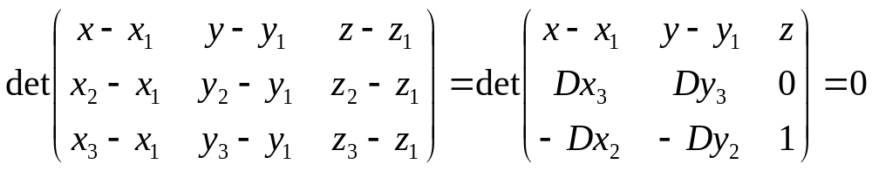
Diffusion term calculation
1
Dx₃
We need to calculate the gradient of
the test functions, computing the
x- and y- derivatives of a plane
passing in (x₁,x₂,x₃), (y₁,y₂,y₃), (0,0,1)‏
Let’s define Dx₁=x₃-x₂, Dx₂=x₁-x₃,
Dx₃=x₂-x₁
From geometrical considerations we obtain that the equation of the plane passing in 3 points is
Dy₃
2
Dy₂
e
Dy₁
Dx₂
3
Dx₁

Slide 8
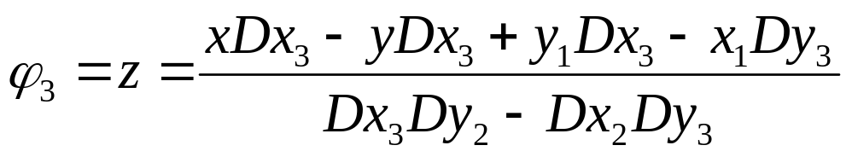
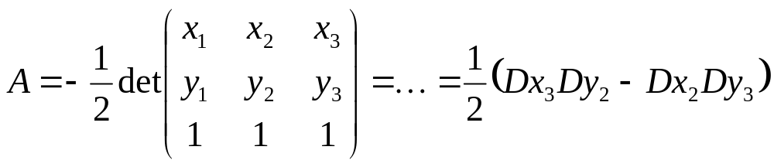
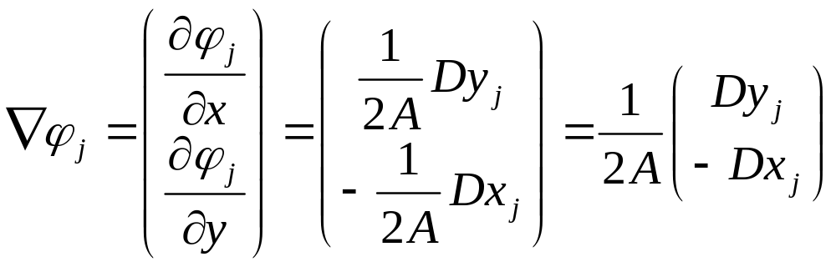
Diffusion term calculation
If we calculate the determinant we obtain
The denominator is 2A_{k} : since the vertices are numbered anti-clockwise the following relationships holds:
In general we have

Slide 9
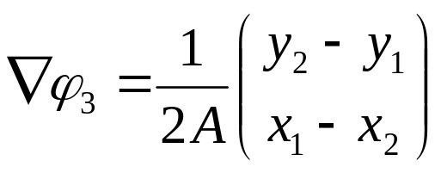
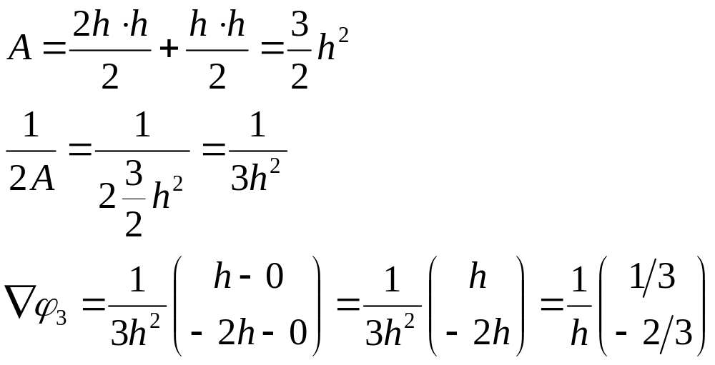
Diffusion term calculation
2: (0,h)
Example: consider the triangle
1: (-2h,0)
3: (h,0)

Slide 10
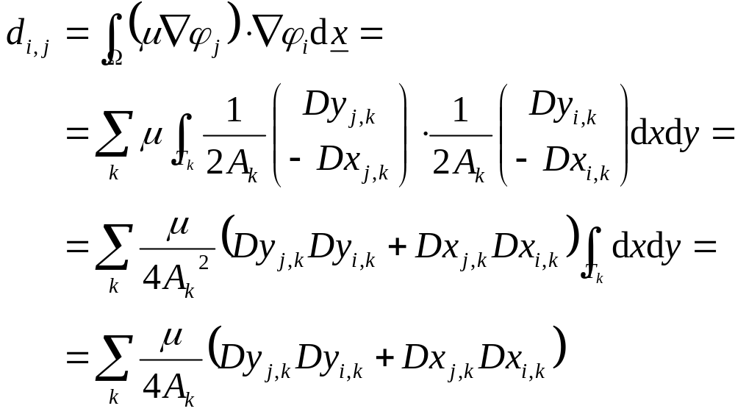
Diffusion term calculation
We evaluate then
where index k runs on all the triangles with vertices i_{k} and j_{k}

Slide 11
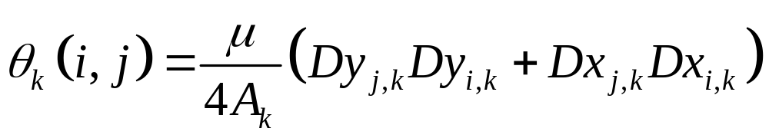
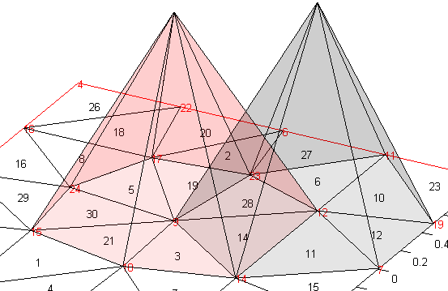
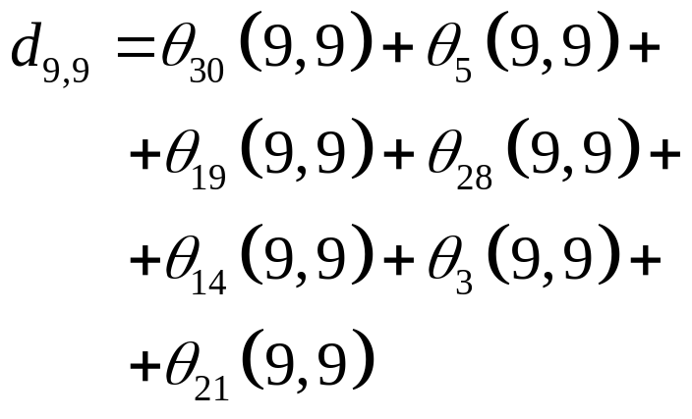
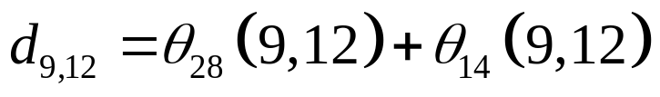
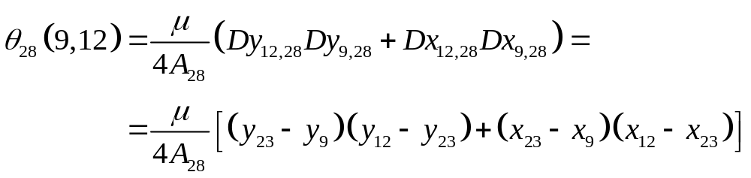
Diffusion term calculation
If we define
9
12

Slide 12
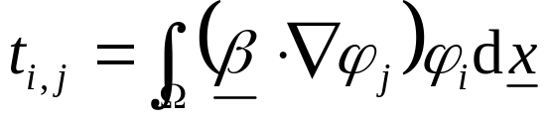
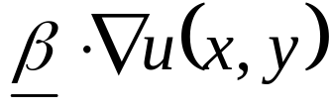
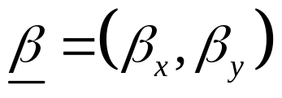
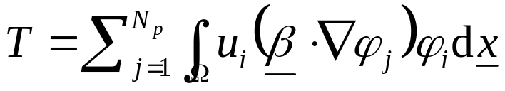
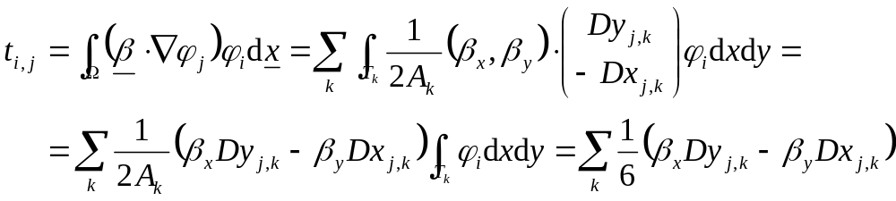
Transport term calculation
Let’s consider the term with
We project on the test functions φj and we expand on function
Recalling the result obtained with the gradient,

Slide 13
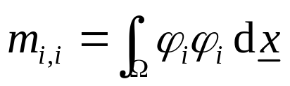
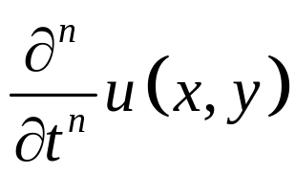
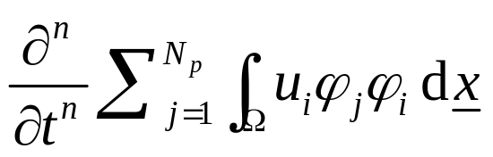
Time-derivative term calculation
We consider now the term
We project on the test functions and we extract the time derivative operator from the space integral
Lets orient the triangle with a vertex in the origin and a side parallel to the y axis
(x₂=x₃,y₂)‏
(x₁,y₁)=O
(x₃,y₃)‏

Slide 14
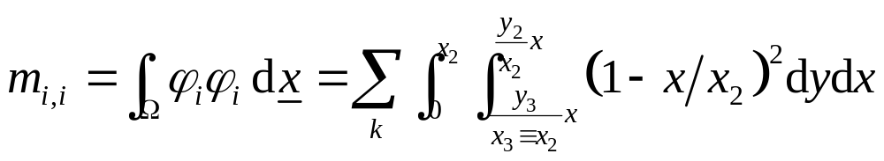
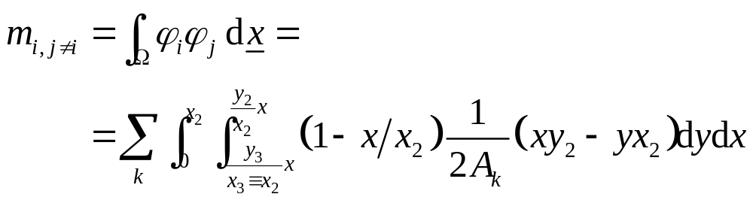
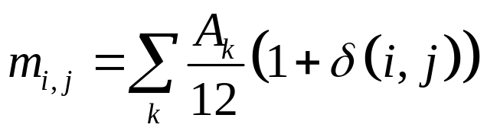
Time-derivative term calculation
We consider the terms with same index i
For the m_{i,j} term we have
(x₂=x₃,y₂)‏
(x₁,y₁)=O
(x₃,y₃)‏
Plane passing in (x3,y3,1)

Slide 15

Time-derivative term calculation
Of course, the integrals can be hand calculated
It is possible to evaluate them using symbolic calculation in MATLAB:
  >> syms x a b real %real symbolic variables
  >> y=cos(x); %analytic expression
  >> diff(y) %derivative
  ans = -sin(x);
  >> z=int(y+x,x,a,b) %func. to int., variable, lim.
  z = -sin(a)-1/2*a^2+sin(b)+1/2*b^2
  >> subs(z,{a,b},{1,2}) %numerical value: a=1, b=2
  ans = 1.5678
  >> simple(cos(x)^2+sin(x)^2) %simplify expr.
  ans = 1

Slide 16
Time-derivative term calculation
  %in this case: first evaluate the inner integral, in dy
  >>syms y3 x2 y2 x y A real
  >>aux=int(
  (1-x/x2)^2, %function to integrate
  y, %integration variable
  y3/x2*x, %lower limit
  y2/x2*x ); %upper limit
  %then evaluate the outer integral, in dx
  >>m_ii=int(aux,x,0,x2);
  >>simple(m_ii)‏
  ans = -1/12*x2*(y3-y2)
- Base
(x₂=x₃,y₂)‏
-2*Area
(x₁,y₁)=O
Triangle heigth
(x₃,y₃)‏

Slide 17
Time-derivative term calculation
  %First, evaluate the inner integral, in dy
  >>syms y3 x2 y2 x y A real
  >>aux=int(
  (1-x/x2)/(x2*(y2-y3))*(x*y2-y*x2),%func.to int.
  y, %integration variable
  y3/x2*x, %lower limit
  y2/x2*x ); %upper limit
  %then evaluate the outer integral, in dx
  >>m_ij=int(aux,x,0,x2);
  >>simple(m_ij)‏
  ans = 1/24*x2*(y2-y3)
(x₂=x₃,y₂)‏
2*Area
(x₁,y₁)=O
(x₃,y₃)‏

Slide 18
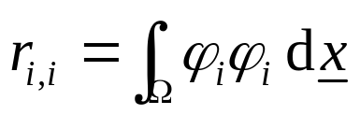
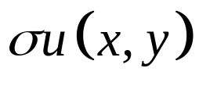
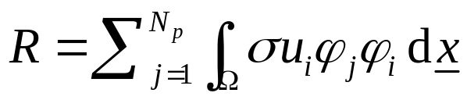
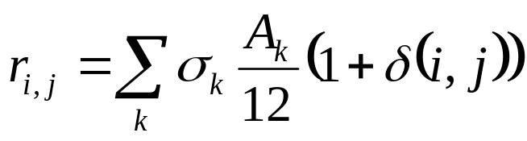
Reaction term calculation
We consider the term with a constant σ
We project on the test functions
This is the same integral we already calculated for the mass matrix!

Slide 19
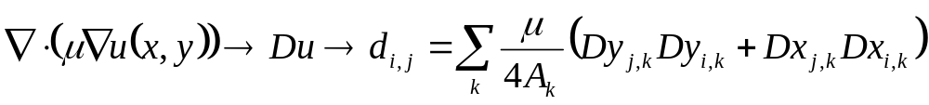
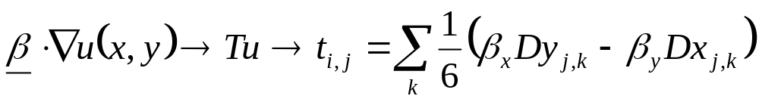
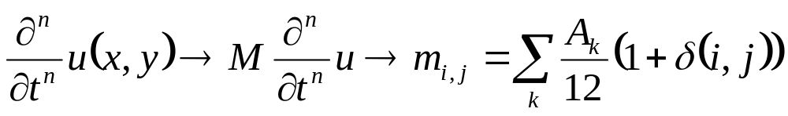
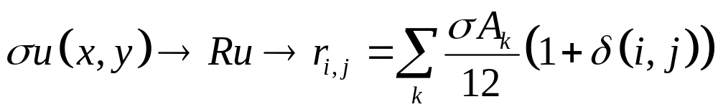
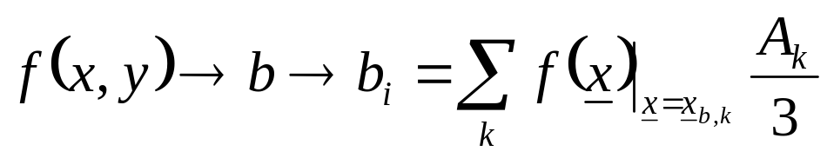

Conclusions
Summarising,
The diffusion-transport-reaction equation can be expressed as

Slide 20

Poisson problem
We want to write a function to solve the Poisson problem in stationary conditions using the finite element method, using the mesh we just generated, and considering homogeneous Dirichlet boundary conditions (BC)
The problem to solve is
We have now to build the stiffness matrix of the problem

Slide 21
Matrices data structure
Since we are dealing with a (possibly) “large” number of dof, it’s important to store the stiffness and mass matrices as sparse.
Since we are going to build these matrices element by element, it’s faster to use MATLAB function sparse and temporarely store in 3 vectors the row index, column index and value of each entry
rows=[1; 1; 2; 3; 1]; cols=[1; 2; 3; 1; 1];
val=[1; 1; 3; 4; 2]; D=sparse(rows, cols, val, 3, 3)
ans = %values in the same position are summed
3 1 0
0 0 3
4 0 0
The number of entries (=length of rows, cols and val vectors) is approximately Me.MatrixContributions

Slide 22
Stiffness matrix construction
For each triangle e
Evaluate Dx, Dy, f(x_{b},y_{b}), mu(x_{b},y_{b})
For each local vertex i ( 1 → 3)
ii=Internal Numbering(i)
If vertex ii is unknown
b(ii) = b(ii) + (Area*f)/3;
For each local vertex j ( 1 → 3)
jj=Internal Numbering(j)
If vertex jj is unknown
A (ii,jj)=A(ii,jj)+ (Dy(i) Dy(j)+Dx(i)Dx(j))/(4*Area)‏*mu
1
Dx₃
Dy₃
2
Dy₂
e
Dy₁
Dx₂
3
Dx₁

Slide 23
function [D,b] = dirichletHomo_BuildStiff(Me,f)‏
  %Input:
  %Me: Mesh object
  %f: external source (MATLAB function)
  %
  %Output:
  %D,b: Matrix and constant terms vector of the
  % system Du=b
  %
  %REMARK:
  %The elastic coefficient is provided trough the %property "mu" assigned to the regions

Slide 24
function [D,b] = dirichletHomo_BuildStiff(Me,f)‏
%Indices of vertices of each triangle; 3 cols. matrix
V = Me.Triangles.Vertices;
%Area of each triangle; column vector
Areas = Me.Triangles.Areas;
%x and y coordinates of the centres of mass;col. vect.
CenterOfMass = Me.Triangles.CenterOfMass;
%x and y coordinates of the certices; column vectors
X=Me.Nodes.X; Y=Me.Nodes.Y;
%Numbering of Dirichlet(<0) and unknown (>0) nodes
Dof = Me.Nodes.Dof;
%number of internal nodes: we know that the numDof %unknown nodes are numbered from 1 to numDof in %Me.Nodes.Dof; its maximum is therefore the number %of unknown (degrees of freedom)
numDof = max(Dof);

Slide 25
function [D,b] = dirichletHomo_BuildStiff(Me,f)‏
%vectors preallocation: instead of allocating the %sparse stiffness matrix with spalloc, we save the %rows, columns and values corresponding to each %contribution; at the end, we'll call sparse(...) to %obtain the diffusion matrix. This solution is much %faster than using spalloc
row = zeros(Me.MatrixContributions, 1);
col = zeros(Me.MatrixContributions, 1);
d = zeros(Me.MatrixContributions, 1);
pos = 1; %we increase this index when we add an entry
b = zeros(numDof, 1);
%force, in the centre of mass of each triangle
force = f(CenterOfMass.X,CenterOfMass.Y);
%coefficient in front of the Laplace operator
mu = Me.evaluateProperty('mu');

Slide 26
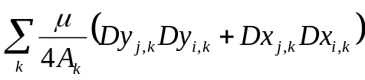
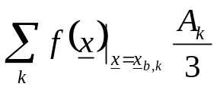
function [D,b] = dirichletHomo_BuildStiff(Me,f)‏
for e= 1:size(V, 1) %main loop over each triangle
Dx(1) = X(V(e, 3)) - X(V(e, 2)); Dy(1) = Y(V(e, 3)) - Y(V(e, 2));
Dx(2) = X(V(e, 1)) - X(V(e, 3)); Dy(2) = Y(V(e, 1)) - Y(V(e, 3));
Dx(3) = X(V(e, 2)) - X(V(e, 1)); Dy(3) = Y(V(e, 2)) - Y(V(e, 1));
for ni = 1:3 %for each vertex of this triangle
ii = Dof(V(e, ni)); %ii can be <0 (Dirichlet) or >0 (dof)
if ii > 0 %is it a dof? If so, 2nd loop
for nj = 1:3
jj = Dof(V(e, nj)); %is it a dof as well?
if jj > 0 %yes, add the contribution to stiffness mat.
Dcomp = (Dy(ni)*Dy(nj)+Dx(ni)*Dx(nj))
d(pos) = mu(e)* Dcomp / (4*Areas(e));
row(pos) = ii; col(pos) = jj;
pos = pos + 1; %ready for the next element
end
end
%add the external contribution to constant terms vector
b(ii) = b(ii) + Areas(e) * force(e) / 3;
end
end
end
%build the sparse stiffness matrix D
D = sparse(row, col, d, numDof, numDof);

Slide 27
Putting all together
  Sh = regions.rect('mu',1);
  Me = mesh2D(Sh,0.05);
  f = @(x,y)-4*ones(size(x));
  [D,b] = dirichletHomo_BuildStiff(Me, f);
  u = D\b;
Vector u contains the solution in the unknown nodes only; additional steps are required to generate the vector to be drawn:
  We allocate a vector having the same size as the number of nodes
  uu=zeros(size(X));
  In the unknown nodes we copy the solution
  uu(Me.Nodes.Dof>0)=u; %unknown nodes
  In the Dirichlet nodes we impose the known values (in this case, an homogeneous Dirichlet condition)
  uu(Me.Nodes.Dof<0)=0; %known nodes
The same result can be obtained using method copyToAllNodes:
uu=Me.copyToAllNodes(u);

Slide 28
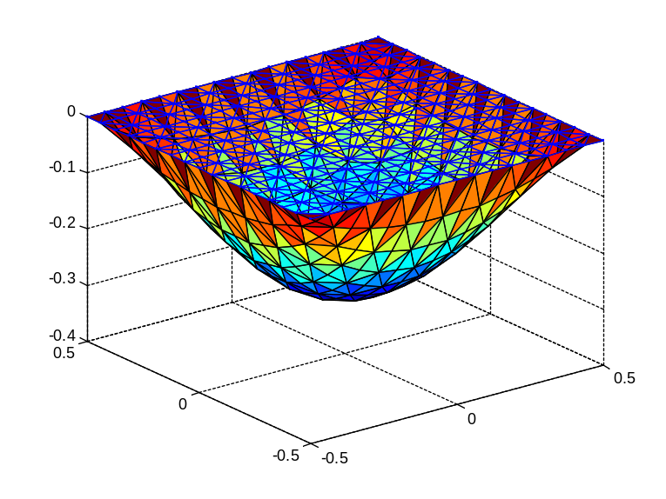
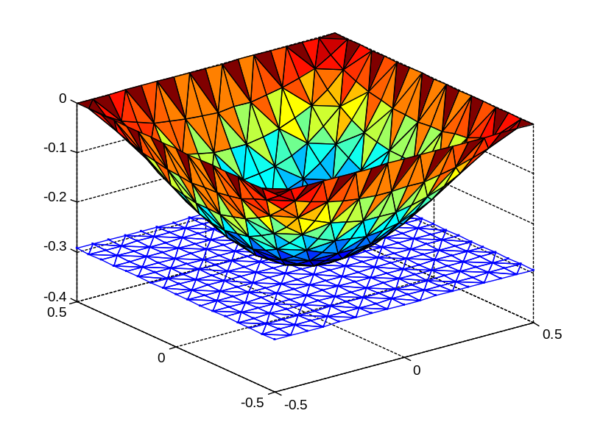
Solution representation
We finally plot the solution using function draw
  >>figure;
  >>Me.draw(uu); >>Me.draw(uu,'offset');

Slide 29
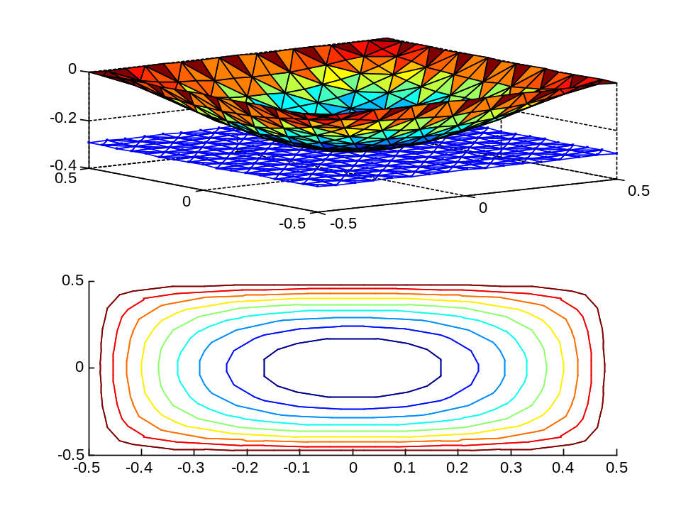
Solution representation
Another possible visualization
  figure;
  subplot(2,1,1);
  Me.draw(uu,'offset');
  subplot(2,1,2);
  Me.draw(uu,'contour');

Slide 30
Function draw
The function draw accepts the following optional arguments
  e, edges numbers the edges
  n, nodes numbers the nodes
  t, triangles: numbers the triangles
  i, internalnodes numbers the unknown nodes
  d, dirichletnodes numbers the known nodes
  q, quality draws the quality factor
  c, contour contour of the solution, hiding the mesh
  o, offset shows the mesh, aligned to the solution minimum
  h, hidemesh hides the mesh
  s, showmesh shows the mesh

Slide 31


Example
S = regions.rect('mu',1) * 2 ...
-regions.rectN([-0.7, 0.3],[-0.3 0.7]) ...
-regions.rectN([-0.7, -0.3],[-0.3, -0.7]) ...
-regions.rectN([0.7, 0.3],[0.3, 0.7]) ...
-regions.rectN([0.7, -0.3],[0.3, -0.7]);
Me = mesh2D(s);
[A,b] = dirichletHomo_BuildStiff(Me);
u = A\b; uu = me.copyToAllNodes(u);
Me.draw(uu);

Slide 32

Example (2 regions)
Sh(1)=regions.rect('mu',1);
Sh(2)=regions.rect('mu',1)+[1,0];
Me=Sh.mesh2D();
[A,b]= dirichletHomo_BuildStiff(Me);
uu=Me.copyToAllNodes(A\b);
Me.draw(uu,'showmesh','offset')

Slide 33

Example
(1 region, non-constant material)
Sh = regions.rect([0.5,0],[2,1], 'mu',@(x,y)(1+(x>0.5)));
Me = mesh2D(Sh);
f = -4*ones(size(x));
[D,b] = dirichletHomo_BuildStiff(Me, f);
uu = Me.copyToAllNodes(D\b);
figure;
Me.draw(uu);

Slide 34
Solution correctness
In order to correctly judge the results of any numerical elaboration, it is always important to evaluate with attention if they represent a realistic result or not, and to try to compare them, if possible, with solutions obtained with other models or from experimental measurements.
When we work with Finite Elements, we can also check if the used mesh was refined enough or not, by estimating how much the solution (in a point, or along a line) changes by changing the maximum triangle side.

Slide 35

findClosestNode mesh2D
The method findClosestNode of the mesh2D class returns the index (in the global numbering) of the closest node respect to the supplied (x,y) point:
  Me = mesh2D(regions.rect());
  Me.draw('node');
  Me.findClosestNode([0.25 0.31])
  % ans = 60
  Called with 2 output arguments
  it also returns the index of the
  triangle which contains (x,y)
  >>[node, triangle] = Find(Me,[0.25, 0.31]);
  >>triangle
  136

Slide 36


Method Interp
It evaluates the solution on the specified points, linearly interpolating the solutions obtained in the vertices of the triangles containing the points
N=200;
ptx=linspace(-0.5,1.5,N).';
pty=zeros(N,1);
%200 pts like (x,0)
z=Me.interpolate(uu,[ptx,pty]);
figure;
plot(ptx,z);

Slide 37


Method interpolate
It is usefull, for instance, to compare solutions obtained with different mesh sizes
S=regions.rect('mu',1);
S.Borders(1).Bc(1)=
boundaries.neumann(0);
Areas=2.^-(3:2:9);
y=zeros(200,1);
x=linspace(-0.5,0.5,200).';
figure; hold on;
for kl=1:length(Areas)
Me=mesh2D(S,Areas(kl));
[A,b]=dirichletHomo_BuildStiff (...
Me,@(x,y)-ones(size(x)));
uu=Me.copyToAllNodes(A\b);
z=Me.interpolate(uu,[x,y]);
plot(x,z);
end

Slide 38
Transport and reaction terms
In order to include transport and reaction terms, the function becomes, for instance
function [D,T,R,b] = dirichletHomo_DiffTransReact_BuildStiff (Me,f)
and where we previously built matrix D as
d(pos)=c(e)*(Dy(ni)*Dy(nj)+Dx(ni)*Dx(nj))/(4.0*Area);
we have to calculate
t(pos)=(-beta(e,1)*Dy(nj)+beta(e,2)*Dx(nj))*1/6;
d(pos)=c(e)*(Dy(ni)*Dy(nj)+Dx(ni)*Dx(nj))/(4.0*Area);
r(pos)=a(e)*Area*(1+(ni==nj))/12;
and then sum the three contribution

Slide 39


Transport-diffusion term
>>[D,T,R,b] = dirichletHomo_DiffTransReact_BuildStiff (Me,f);
>>u = (D+T)\b;
What happens if we change Beta?
Beta=[1, 1]
Beta=[30, 30]

Slide 40


Transport-diffusion term
Let be the Péclet number local to each triangle k, with h_{k} length of the longest side
It can be shown that if P_{e} >1 the solution becomes oscillating when we approach the boundary layer, whose dimension is approximately
To avoid this problem we can refine the mesh near the boundary layer inserting regions with lower values of the MeshMaxArea property

Slide 41


Transport-diffusion term
Beta=[30, 30]
Uniform mesh Refined mesh
Other much mode sophisticated techniques exist (GLS, SUPG, DW,…)‏

Slide 42

Non-homogeneous Dirichlet conditions
Let’s consider the system Au=b, with A built on all the nodes (and not only the internal ones): size(A)=length(Me.Nodes.X)
Let u₂ and u₄ be nodes with Dirichlet boundary conditions and u₁, u₃ internal nods

Slide 43

Non-homogeneous Dirichlet conditions
The system is equivalent to the following, where u₂ (known quantity) is moved to the right side of the equality

Slide 44


Non-homogeneous Dirichlet conditions
The same can be applied to u₄
and the system can be reduced to

Slide 45
Non-homogeneous Dirichlet conditions
The problem can be reduced to the following linear system, where the only unknown quantities refer to internal nodes
Summary: if node i is adjacent to a node j having non homogeneous Dirichlet BC, we have to evaluate the term k_{ij} and subtract the quantity k_{ij} u_{j} to b_{i}

Slide 46

Non-homogeneous Dirichlet conditions: example
Lets consider a squared geometry
Sh=regions.rect('mu',1)+[0.5 0.5];
Sh.draw('edge')
We apply non homogeneous Dirichlet B.C.s on edges 2, 3, and 4:
  The height of edge 3 is 1
  On edges 2 and 4 the displacement is x
  On edge 1 we have 0 displacement (homogeneous Dirichlet B.C.)
We include diffusion effects only
  Sh.Borders(1).Bc(3) =
  boundaries.dirichlet(1);
  Sh.Borders(1).Bc([2,4]) = boundaries.dirichlet(@(x,y)x);
  Me=mesh2D(Sh,1e-3);

Slide 47
function [D,b] = dirichletNonHomo_BuildStiff(Me,f)
%in the main loop...
for ni = 1:3
ii = Dof(V(e,ni)); %is it a dof?
if ii > 0 %yes! second loop on the vertices
for nj = 1:3
jj = Dof(V(e,nj));
Dcom = (Dy(ni)*Dy(nj)+Dx(ni)*Dx(nj));
dtmp = c(e)*DCom/(4.0*Areas(e));
if jj > 0 %is it a dof as well? d(pos) = dtmp; row(pos) = ii; col(pos) = jj; pos = pos+1;
else
val = Me.BC.DirichletNodes(-jj,2);
b(ii) = b(ii) - dtmp*val ;
end
end
b(ii) = b(ii) + Areas(e)*force(e)/3.0;
end
end

Slide 48

Program execution
[D,b]= dirichletNonHomo_BuildStiff(Me,f);
uu=Me.copyToAllNodes(D\b);
figure;
subplot(2,1,1);
Me.draw(uu,'offset');
subplot(2,1,2);
Me.draw(uu,'contour');

Slide 49

Homogeneous Neumann boundary conditions
The code we already wrote is
able to handle sides with
homogeneous Neumann B.C.s
Sh = regions.rect('mu',1);
Sh.Borders(1).Bc(1) =
boundaries.neumann(0);
Me = mesh2D(Sh,0.05);
f = @(x,y)-4*ones(size(x));
[D,b] =
dirichletHomo_BuildStiff(Me,f);
u=D\b;

Slide 50



Non-homogeneous Neumann boundary conditions
We consider the Poisson problem
with boundary conditions on
This means that we impose that the solution has a derivative equal to g on the domain boundary
We project on an arbitrary test function v
and we apply the Green Theorem
We need to evaluate the term

Slide 51


Non-homogeneous Neumann boundary conditions
The term represents the
area of a triangle with height 1
and a base equal
to the distance between
nodes i and j.
Its it therefore
1
i
j

Slide 52
function [A,b] = neumannNonHomo_BuildStiff(Me,f)
The code is the same as the one we wrote for homogeneous Dirichlet boundary conditions
After the loop over the triangles, we add to the constant terms vector the contribution of the non-homogeneous Neumann BC:
  For each side with a Neumann condition
    Evaluate its length L
    Get the value g, imposed using boundary.Neumann(g) and stored in the second column of Me.BC.NeumannEdges
    For each vertex which is a dof, add g/2*L to the corresponding element in the constant terms vector.
    NB: the nodes of a Neumann edge can be: a) both dofs or b) 1 dof and 1 Dirichlet node, if the edge is connected to a Dirichlet B.C.

Slide 53
function [A,b] = neumannNonHomo_BuildStiff(Me,f)
%after the loop over the triangles
Edges=Me.Edges;
Neumann=Me.BC.NeumannEdges;
for k=1:size(Neumann,1) %loop over each Neumann edge
Node1=Edges(Neumann(k),1); %index of node 1
Node2=Edges(Neumann(k),2); %index of node 2
dx=Nodes.X(Node1)-Nodes.X(Node2);
dy=Nodes.Y(Node1)-Nodes.Y(Node2);
L=sqrt(dx*dx+dy*dy); %edge length
g=Me.BC.NeumannEdges(k,2); %Neumann condition
if Dof(Node1)>0 %if node 1 a dof?
b(Dof(Node1))=b(Dof(Node1))+g/2*L;
end
if Dof(Node2)>0
b(Dof(Node2))=b(Dof(Node2))+g/2*L;
end
end

Slide 54

Non-homogeneous Neumann boundary conditions
Sh = regions.rect('mu',1);
Sh.Borders(1).Bc(4) = ...
boundaries.neumann(-5);
Me = mesh2D(Sh,1e-3);
f = @(x,y)-4*ones(size(x));
[D,b] = neumannNonHomo_BuildStiff(Me,f);
uu = Me.copyToAllNodes(D\b);
figure; Me.draw(uu);

Slide 55



Numerical gradient evaluation
The equation of a plane passing for in (x_{j},y_{j},z_{j}) can be obtained solving
and therefore it is
We have then

Slide 56



Numerical gradient evaluation
Method gradient returns the gradient of the solution
  [dudx,dudy]=Me.gradient(uu);
  Me.draw(dudx);
  Me.draw(dudy);
uu solution
dudx
dudy
x
y

Slide 57



Example #1: Darcy law
Darcy law describes the flow of a fluid in porous medium with permeability k_{p} and viscosity µ:
Starting from Navier-Stokes equation, under the hypothesis of uncompressible fluid, we obtain that the velocity field is solenoidal
By taking the divergence of Darcy law we obtain
and therefore the pressure field is described by the Poisson equation
We now calculate the pressure and velocity profiles on a generic domain

Slide 58



Example #1:
1 – domain definition
We consider a curved pipe connected to two linear pipes
Since we are working with curved regions, it’s a good practice to define a grid using the grid2D class
grid2D.setSteps(1e-6);
S=regions.rect([-1 3.5],[2 1])+...
regions.sector([0,0],4,3,[0 90],8)+...
regions.rect([3.5 -1],[ 1 2])
figure;S.draw('e');
Without the grid, numerical errors introduced by the finite precision of the computer, could introduce extra, wrong, edges when combining the regions

Slide 59



Example #1:
2 – boundary conditions definition
A simple approach is to assign the velocities
in two terminal edges (= non homogeneous
Neumann B.C.) and homogeneous
Neumann conditions of the other edges.
S.Borders.Bc(:) = boundaries.neumann(0);
S.Borders.Bc(9) = boundaries.neumann(-4);
S.Borders.Bc(20)= boundaries.neumann(4);
In this way the problem presents only Neumman B.C.s
and presents therefore an infinite number of solutions, all with the same derivative (= velocity profile): if we want to obtain a correct solution for the pressure field we need to assign a Dirichlet B.C. in at least one point (or one edge):
S.Borders.Bc(20) = boundaries.dirichlet(PressureIn);
Of course, we can also apply Dirichlet B.C.s on the two terminal edges, specifying the in and out pressures:
S.Borders.Bc(9) = boundaries.dirichlet(PressureOut);
S.Borders.Bc(20) = boundaries.dirichlet(PressureIn);

Slide 60

Example #1:
3 – Mesh, 4 – Stiffness matrix
%Mesh
Me = mesh2D(S,1e-2);
figure;
Me.draw();
%Stiffness matrix:
%in this case there is no
%external source, but we need
%to include the non Homogeneous
%Neumann B.C.s, and/or the
%non Homogeneous Dirichlet B.C.s.
[D,b] = BuildStiffnessDarcy(Me);

Slide 61



Example #1:
5 – Solution, 6 – plot
%Calculate and draw the pressure
uu = Me.copyToAllNodes(D\b);
figure;
Me.draw(uu);
% Calculate and draw the velocity
%
[ux,uy] = Me.gradient(-uu);
figure;
quiver(Me.Nodes.X, Me.Nodes.Y,...
ux, uy);

Slide 62
Numerical integral evaluation
The integral can be easily evaluated using a formula which is the generalization of the trapezium method we used in the 2D case:
  For each triangle e with vertices (i,j,k) we calculate the volume of the prism A_{e}(u_{i}+u_{j}+u_{k})/3; we then add these partial volumes together
The method Me.integrate(uu) calculates the numerical integral of the solution over the whole domain
If more than one region was used, it is possible to evaluate the integral only on certain regions passing their indices as 3rd parameter
  >>I=Me.integrate(uu, [1 4]);
  %it evaluates the integral over the regions 1&4

Slide 63





Robin boundary conditions
In the 1D case, Robin Boundary conditions correspond to impose that the solution, at the end of the interval, respects the condition
The solution is
In other words, we require the solution to exponentially tend to the value g/h
In the 2D case we have which can also be written as with
u₀
g/h
0

Slide 64

Robin boundary conditions
Lets consider the Poisson equation
with BC on
This means that we impose that the solution trends to the value g with an exponential behaviour
We project on an arbitrary test function v
We apply the Green theorem
We already evaluated (non-homogeneous Neumann BC) the term related to
We have to evaluate numerically

Slide 65


Robin boundary conditions
Lets then evaluate
We remember that the integration line is the base of a triangle lying on a plane which is othogonal to the xy plane; we call d the length of such a base and we evaluate the integral by placing ds parallel to the base itself
These contributions create a matrix having the same size as the stiffness matrix

Slide 66
Robin boundary conditions
When we encounter Robin BC, we need therefore to evaluate some contributions on the dofs lying on the domain border
If the side l presents Robin BC, and if the node ii1 on such a side is a dof, we need to evaluate
  A contribution to the constant terms vector
    b(ii1)=b(ii1)+g/2*dist;
  A contribution on the main diagonal of the stiffness matrix
    D(ii1,ii1)=D(ii1,ii1)+h*dist/3;
  (If both the side’s nodes are dof) the mutual contributions outside the main diagonal of the stiffness matrix
    D(ii1,ii2)=D(ii1,ii2)+h*dist/6;

Slide 67
function [D,b] = robin_BuildStiff(Me,f)‏
%after the loop over the triangles
Robin=Me.BC.RobinEdges;
for k=1:size(Robin,1)
Node1 = Edges(Robin(k,1),1); Node2 = Edges(Robin(k,1),2);
dx = Nodes.X(Node1) - Nodes.X(Node2);
dy = Nodes.Y(Node1) - Nodes.Y(Node2);
L = sqrt(dx*dx+dy*dy); %edge length
ii1 = Dof(Node1); ii2 = Dof(Node2);
g = Robin(k,3); h = Robin(k,2);
if ii1>0 && ii2<0 %ii1 is dof, ii2 is known
b(ii1) = b(ii1)+g/2*L; row(pos) = ii1; col(pos) = ii1;
d(pos) = h*L/3; pos = pos+1;
elseif ii1<0 && ii2>0 %ii1 is known, ii2 is dof
b(ii2) = b(ii2)+g/2*L; row(pos) = ii2; col(pos) = ii2;
d(pos) = h*L/3; pos = pos+1;
else %both are dof: 4 contributions to D
b(ii1) = b(ii1)+g/2*L; b(ii2) = b(ii2)+g/2*L;
row(pos:pos+3)=[ii1;ii2;ii1;ii2];
col(pos:pos+3)=[ii1;ii2;ii2;ii1];
d(pos:pos+3)=[2;2;1;1]*h*L/6;
pos=pos+4;
end, end

Slide 68

function [A,b] = BuildStiffnessDiffRobin (Me,f)‏
S = regions.rect('mu',1);
%the solution exponentially goes to the value g/h
S.Borders(1).Bc(1) = boundaries.robin(2,-2); %h=2,g=-2
Me=mesh2D(Sh,0.03);
[D,b]= robin_BuildStiff(Me,@(x,y)zeros(size(x)));
uu = Me.copyToAllNodes(D\b);
figure;
Me.draw(uu);

Slide 69
Robin and non-homogen. Dirichlet conditions
The previous formulation is correct for all the sides with a Robin condition, and even for the sides that “touch” edges with homogeneous Dirichlet conditions.
If, on the contrary, an edge with Robin BC has a vertex with a NON-homogeneous Dirichlet condition, we need to add a contribution also to the constant terms vector (for simplicity D is considered here as full matrix)
...
if ii1>0 && ii2<0 %ii1 dof, ii2 known
Dirichlet=Me.BC.DirichletNodes(-ii2,2);
b(ii1) = b(ii1)+g/2*dist-h*dist/6*Dirichlet;
D(ii1,ii1) = D(ii1,ii1)+h*dist/3;
elseif ii1<0 && ii2>0 %ii1 known, ii2 dof
Dirichlet=Me.BC.DirichletNodes(-ii1,2);
b(ii2) = b(ii2)+g/2*dist-h*dist/6*Dirichlet;
D(ii2,ii2)=D(ii2,ii2)+h*dist/3;
else %Then ii1 and ii2 are both dof
...

Slide 70

Periodic boundary conditions
Lets consider the elementary cell of a periodic structure
We cannot apply the techniques we have encountered up to now: we only know that the solution is the same at the opposite edges

Slide 71
Periodic boundary conditions
In the previous slide the periodicity is only in the x –direction and, if the domain is centred around the origin, from a generic (x,y) point placed on the left (right) border we can easily obtain corresponding “twin” node on the right (left) border, since its coordinates are (-x,y)
When we define the BC we write then
S.Borders(1).Bc(1)=boundaries.periodic(@(x,y)[-x,y]);
S.Borders(1).Bc(3)=boundaries.periodic(@(x,y)[-x,y]);
  to indicate that the twin nodes can be obtained by getting the (–x, y) coordinates of the original node

Slide 72
Periodic boundary conditions
If we have a grid periodic in both x and y directions, we use
S.Borders.Bc(1)=boundaries.periodic(@(x,y) [-x,y]);
S.Borders.Bc(3)=boundaries.periodic(@(x,y) [-x,y]);
S.Borders.Bc(2)=boundaries.periodic(@(x,y) [x,-y]);
S.Borders.Bc(4)=boundaries.periodic(@(x,y) [x,-y]);

Slide 73
Periodic boundary conditions
If we have an hexagonal fundamental cell, we use
  f25=@(x,y)0.5*[-x-sqrt(3)*y, -sqrt(3)*x+y];
  f36=@(x,y)0.5*[-x+sqrt(3)*y, sqrt(3)*x+y];
  S.Borders(1).Bc(1) = boundary.periodic(@(x,y)[x,-y]);
  S.Borders(1).Bc(4) = boundary.periodic(@(x,y)[x,-y]);
  S.Borders(1).Bc(2) = boundary.periodic(f25);
  S.Borders(1).Bc(5) = boundary.periodic(f25);
  S.Borders(1).Bc(2) = boundary.periodic(f36);
  S.Borders(1).Bc(4) = boundary.periodic(f36);
1
6
2
1
6
2
5
3
4
5
3
4

Slide 74

Periodic boundary conditions
We can also use periodic boundary conditions to study problems whose domain lies on the surface of a cylinder
S.Borders(1).Bc([1,4]) = ...
boundaries.periodic(@(x,y)[x,-y]);

Slide 75
Periodic boundary conditions
The object Me contains the fields Me.Nodes.TwinNode, vector whose length is equal to the total number of nodes
For each node k,
  if Me.Nodes.TwinNode(k)=0, then the node k does not belong to an edge with periodic conditions (so there is nothing to do)
  otherwise, Me.Nodes.TwinNode(k) contains the index of the twin node of the node k in the dof numbering. We’ll have to modify the stiffness matrix.

Slide 76
Periodic boundary conditions
Lets study a structure periodic in only one direction
When we build the stiffness matrix and we consider the node , on the diagonal we find the contribution of triangles 1, 2, 3, but if we consider the periodic structure, also triangles 4,5, 6 bring a contribution
4
1
4
5
2
5
6
3
6

Slide 77
Periodic boundary conditions
In a similar way, the node gives a contribution both on the node and on its twin on the other side
The field Me.PeriodicNodes allows to easily obtain the index of node given the node (and vice versa)
4
1
4
5
2
5
6
3
6

Slide 78
Periodic boundary conditions
In the loop used to build the stiffness matrix we have
if jj > 0 %add contribution to the stiffness matrix Dtmp = Dy(ni)*Dy(nj)+Dx(ni)*Dx(nj)
d(pos) = mu(e)*Dtmp/(4.0*Areas(e));
row(pos) = ii; col(pos) = jj; pos = pos+1;
gem=Me.Nodes.TwinNode(V(e,ni));%any twin node?
if gem > 0 %yes! add to the twin node too
row(pos) = gem;
if nj~=ni, col(pos)=jj; else, col(pos)=gem; end
d(pos) = mu(e)*Dtmp/(4.0*Areas(e)); pos = pos+1;
end
end
NB!!! The same logic applies when an external force is present, and for non homogeneous Dirichlet, non homogeneous Neumann, Robin B.C.s

Slide 79

Periodic boundary conditions
We consider a diffusion problem with
f = @(x,y)(4.*(x<-.5).*(x>-1.5).*(abs(y)<.5)...
-1.*(x>.5).*(x<1.5).*(abs(y)<.5));
which returns 4 in the red regions and -1 in the blue one

Slide 80


Periodic boundary conditions
The solution is really
periodic!

Slide 81


Periodic boundary conditions
By imposing Neumann
conditions we have no
continuity at the borders
anymore
It is possible to apply
Neumann boundary
conditions only if the
phenomenon extinguishes
at the borders

Slide 82

Example #2
We consider a T-like structure, made by 3 regions, each one having a different elastic coefficient
Boundary conditions are indicated in the figure
N
P
P
μ=1
μ=1E-3
N
N
D
N
N
μ=2
N

Slide 83

Example #2
1 – domain definition
S(1) = regions.rect([0,0.5],[10,1],'mu',1)- regions.rect([0,0.5],[3,0.3]);
S(2) = regions.rect([0,-1],[8,2],'mu',2)- regions.circle([0,-1],0.5);
S(3) = regions.rect([0,0.5],[3,0.3],'mu',1e-3);
figure;S.draw('n');
%Add (4,0)&(-4,0) to region 1, border 1, after node 1
S(1).Borders(1) =
S(1).Borders(1).insertNode(1,[4 0;-4 0]);
figure;
S.draw('e');

Slide 84


Example #2
2 – boundary conditions definition
S(1).Borders(1).Bc([1,3,5]) = boundary.neumann(0);
S(1).Borders(1).Bc(2) = boundary.continuity();
S(1).Borders(2).Bc(:) = boundary.continuity();
S(2).Borders(1).Bc([1,2,4]) = boundary.neumann(0);
S(2).Borders(1).Bc(3) = boundary.continuity();
S(3).Borders(1).Bc(:) = boundary.continuity(); S(1).Borders(1).Bc([6,4]) = ... boundary.periodic(@(x,y)[-x,y]); S.draw('bc');

Slide 85

Example #2
3 – mesh
Me = mesh2D(S, 0.001);
figure;
Me.draw('d');
Apply an the external source in the highlighted regions
xyc1 = [-3,0.5]; %center of yellow box, f=+1
xyc2 = [-2.5,-1.5]; %center of red box, f=-1
wh = [1,0.5]; %width & height of both regions
f = @(x,y)InRect([x,y],xyc1,wh)
-InRect([x,y],xyc2,wh);

Slide 86


Example #2: 4 – stiffness matrix construction, 5 – solution, 6 – plot
We build the stiffness matrix and we solve the problem
[D,b] = periodic_BuildStiff (Me, f);
uu = Me.copyToAllNodes(pcg(D, b, 1e-3, 1000));
figure;
Me.draw(uu, 'offset'); title('Periodic conditions');

Slide 87






Example #3
(RunCoupledSystems.m)
Let’s consider two elastic surfaces linked togheter
The borders of the first one are placed in z=0, while the borders of the second one are placed in z=2
NB: we consider Dirichlet B.C.s only. The case with different B.C.s on the top and bottom surfaces requires more attention to consistently re-map the unknown nodes of the two domains; see Example #3/b

Slide 88

%domain with %Dirichlet hom. on the 4 sides
S1 = regions.rect('mu',1, 'sigma',1);
Me1 = mesh2D(S1); %first mesh
Me1.draw();
%Stiffness matrix
[D1,R1,b1] = coupledDirichlet_BuildStiff(Me1);
%Domain with non hom. Dirichlet on the 4 sides (z=2)
S2 = regions.rect('mu',5, 'sigma',1);
S2.Borders(1).Bc(:) = boundaries.dirichlet(2);
Me2 = mesh2D(S2); %second mesh
%stiffness matrix
[D2,R2,b2] = coupledDirichlet_BuildStiff(Me2);

Slide 89


Example #3
Direct method
We solve the system directly, using a new unknown vector u obtained concatenating the two systems u₁ and u₂:
  Atotal=[D1+R1 –R1; -R2 D2+R2];
  btotal=[b1;b2];
  u=Atotal\btotal;
  u1=u(1:end/2);
  u2=u(end/2+1:end);

Slide 90

Example #2
Iterative method
Lets suppose we know u₁ : we can then calculate u₂.
Once we know u₂, we can re-calculate u₁.
We repeat this loop until the relative change of u₁ in (0,0) between two iterations is less than the required tolerance
poscenter=Me2.findClosestNode(Me2,[0,0]);
poscenterlocal=Me2.Nodes.Dof(poscenter);
u1old=0;
while err>toll && iter<itermax
u1=pcg(D1+R1,b1+R1*u2,1e-5,2000);
u2=pcg(D2+R2,b2+R2*u1,1e-5,2000);
iter=iter+1;
err= abs(u1(poscenterlocal)-u1old);
u1old=u1(poscenterlocal);
end

Slide 91

Example #2 /b
(RunCoupledSystems2.m)
In the previous case, the applied B.C.s where the same and we take advantage of the correspondence between the unknown nodes of the two membranes (i.e. unknown node 34 in the top membrane was connected to node 34 in the bottom membrane.
This is not anymore true if the B.C.s applied on corresponding edges are different; in this case also the number of unknown nodes is not the same
The top membrane has a Neumann B.C.
While the total number of nodes is 81 for both the geometries, the number of unknown nodes is 81-25 in the top one, and 81-32 in the bottom one.

Slide 92


Example #2 /b
The only solution is therefore to build the full stiffness matrix, considering all the nodes, also the Dirichlet ones.
We therefore need to generate matrices D according to this schema (with u₂ and u₄ Dirichlet nodes)
while matrices R are
The mass matrices must be generated in a similar way

Slide 93
Example #3 /b
BuildStiffnessCoupledSystems2
for i=1:3
ii = Tr(e,i); %ii in the global numbering!
if NI(ii) > 0 %dof?
for j=1:3
jj = Tr(e,j); %add the value
d=mu(e)*(Dy(i)*Dy(j)+Dx(i)*Dx(j))/(4.0*Area(e)); r=sigma(e)*Area(e)*(1+(i==j))/12;
%suppose D and R full for simplicity
D(ii,jj)=D(ii,jj) + d;
R(ii,jj)=R(ii,jj) + r;
end
end
end
%diagonal 1s and values on the const. terms vector ii=Me.BC.DirichletNodes(k,1);
D(ii,ii)=1;
b(ii)=Me.BC.DirichletNodes(k,2);
end

Slide 94

Example #3 /b
Atot=[D1+R1 -R1; -R2 D2+R2];
btot=[b1;b2];
uu=Atot\btot;
uu1=uu(1:end/2);
%uu1 is the displacement in all the nodes of region1
uu2=uu(end/2+1:end);
%uu2 is the displacement in all the nodes of region2
figure;
Me1.draw(uu1,'h');
hold on;
Me2.draw(uu2,'h');

Slide 95




Heat equation

Slide 96

Example #4
We consider a square domain of side 1m. This domain is representative of a horizontal section of a chimney. Within the square domain is placed a circular pipe carrying fumes. The temperature of these fumes is assumed constant and equal to 40°C. The characteristics of the pipe are as follows: outer radius 25cm, 10cm thick.
The chimney is thermally insulated on two opposite sides. On the other two sides, the chimney is in contact with the ambient air. On the windward side, assume a Robin boundary condition with T∞=10°C. On the leeward side, assume a constant temperature on the wall, equal to 10°C. Inside the chimney assume continuity of the contact temperature between the tube and the chimney.
For the materials, consider a brick chimney in thermal conductivity of 0.8W/(m K) and an aluminum tube of thermal conductivity 260W/(m K); it uses a coefficient of convective heat transfer equal to 10W/(m² K).
25 cm
10 cm
1 m

Slide 97
Example #4
In a MATLAB script, implement the following steps.
Using the library region generate a geometry representative of the problem
Associate the correct boundary conditions according to the data available in the problem description
Generate the mesh
Open the MatLab function dirichletHomo_BuildStiff (available in the folder “Examples\BasicBCs_Diffusion”) and adapt it by following the steps listed below
Using the attributes of the mesh just created in part A, find the information describing the boundary conditions
If necessary, modify the calculation of the stiffness matrix and the constant terms vector to take into account the Dirichlet / Neumann / Robin boundary conditions
Consider whether you need to add any external force in the calculation
Solve the problem numerically and plot the temperature trend on a section along one of the domain diagonals
Evaluate the flux exchanged with the air on the side with Robin B.C.

Slide 98

Example #4
1 – domain definition
DensityBricks = 1500;
ThermalConductivityBricks = 0.8;
SpecificHeatCapacityBricks= 790;
DensityAl = 2700;
ThermalConductivityAl = 260;
SpecificHeatCapacityAl = 900;
DiffusivityBricks=ThermalConductivityBricks/ (DensityBricks*SpecificHeatCapacityBricks);
DiffusivityAl=ThermalConductivityAl/ (DensityAl*SpecificHeatCapacityAl);
ConvectiveHeatTransfer = 10;
Sh(1)=regions.rect('mu', DiffusivityBricks)- regions.circle([0,0],0.25);
Sh(2)=regions.circle([0,0],0.25,'mu', DiffusivityAl)- regions.circle([0,0],0.10);
Sh.draw('edge');
axis equal;

Slide 99

Example #4
2 – boundary conditions definition
Tair = 10; Tpipe = 40;
Sh(1).Borders(1).Bc([1,3]) = boundaries.neumann(0);
Sh(1).Borders(1).Bc(2) = boundaries.dirichlet(Tair);
Sh(1).Borders(1).Bc(4) = boundaries.robin( ConvectiveHeatTransfer,
ConvectiveHeatTransfer *Tair);
Sh(1).Borders(2).Bc(:) =
boundaries.continuity();
Sh(2).Borders(2).Bc(:) =
boundaries.dirichlet(Tpipe);
Sh(2).Borders(1).Bc(:) =
boundaries.countinuity();
figure;
Sh.draw('bc');
axis equal

Slide 100

Example #4
3 – mesh
Me = mesh2D(Sh,0.03);
figure;
Me.draw('dirichlet');
axis equal

Slide 101
Example #4
4 – stiffness matrix construction
We need to build a function to assemble the stiffness matrix accounting for the following B.C.s:
  Non homogeneous Dirichlet
  Homogeneous Neumann
  Robin
We do NOT need to include an external force
We can therefore start from an already available function, such as BuildStiffnessDiffDirichletNonHomo (handling non homogeneous Dirichlet B.C.s), adding the code for the Robin B.C.s
See function chimney_BuildStiff for the complete construction of the stiffness matrix

Slide 102

Example #4
5 – linear system solution & 6 – plot
[A,B]= chimney_BuildStiff (Me);
T = A \ b; %or, e.g., T = pcg(D,b,1e-5,1000);
TT = Me.copyToAllNodes(T);
figure;
Me.draw(TT);

Slide 103


Example #4
6 – interpolation
x=-0.5:0.01:0.5;
y=x;
TDiag=Me.interpolate(TT, [x;y]');
figure;
plot(x,TDiag,'r');
ylabel('Temperature [^\circC]');
xlabel('Diagonal [m]');
grid on;

Slide 104


Example #4
Flux calculation
To evaluate the flux per meter of
height exchanged between the right
vertical side and the air, we calculate
This expression can be approximated as
  with k index of the edges on the Robin side having length l_{k}, and T_{k,1} and T_{k,2} temperatures at the two vertices of edge k

Slide 105
Example #4
Flux calculation
%couples of indices of the nodes
Nodes=Me.Edges(Me.BC.RobinEdges(:,1),:);
Flux=0;
%for exch Robin edge
for k=1:size(Nodes,1)
Node1=Nodes(k,1);
Node2=Nodes(k,2);
%the node are on vertical segments, I calculate its %length simply as difference of the y-coordinates
dy=Me.Nodes.Y(Node1)-Me.Nodes.Y(Node2);
%temperature on the two nodes
T1=TT(Node1);
T2=TT(Node2);
Flux=Flux+((T1-10)+(T2-10))*abs(dy);
end
Flux=Flux*ConvectiveHeatTransfer/2;

Slide 106


Geometry simplification
It is often possible to reduce the
dimension of the domain under
exam, due to particular symmetries
of the domain, the BCs and
the external forces. In this way
reduce the number of unknowns
and the memory/time required to
solve the problem
Example: squared domain,
constant μ and Dirichlet BC on the
4 sides, f even function: the solution
as well is even. I consider ¼ of the
domain placing homogeneous
Neumann conditions on the internal edges

Slide 107
Geometry simplification
Also, in the chimney problem, it was possible to analyse only half domain to the vertical symmetry, applying an homogeneous Neumann B.C. on the symmetry axes.
Homogeneous
Neumann

Slide 108


Geometry simplification
If on the contrary the force is odd,
it is possible to study ¼ of
the domain, imposing
homogeneous Dirichlet
conditions on the internal
edges

Slide 109


Cylindrical Coordinates
If the 3D geometry we are interested in shows a cylindrical symmetry, then we can reduce it to a 2D geometry
Therefore
and it is simply required to modify the transport term!
r
x

Slide 110


Cylindrical Coordinates
The term , when a sufficiently dense mesh is used, can be approximated as with r_{B} distance of the center of mass to the symmetry axes.
The inner loop used for the stiffness matrix construction becomes therefore (see cylindrical_BuildStiff)
betax = beta(e,1);
betar = beta(e,2)-mu(e)/rb; %correction for cylind. coords
diffusion=mu(e)*(Dr(i)*Dr(j)+Dx(i)*Dx(j))/(4.0*Areas(e)); transport=-(betax*Dr(j)-betar*Dx(j))*1/6;
if jj > 0
row(pos)=ii; col(pos)=jj;
d(pos)= diffusion + transport; pos=pos+1;
else
value=Me.BC.DirichletNodes(-jj,2);
b(ii)=b(ii)-(diffusion+transport)*value;
end

Slide 111

Cylindrical Coordinates
Let’s consider a 2m high cylinder with a base diameter of 1m, full of water whose external temperature is fixed at 10°C. In the center of the cylinder is placed a sphere having a temperature of 20°C
correct
wrong

